Slide 1
LOOK CLOSELY – FIND SOMETHING WRONG IN THE PICTURE FOR AN ASIAN SETTING ???

Slide 2
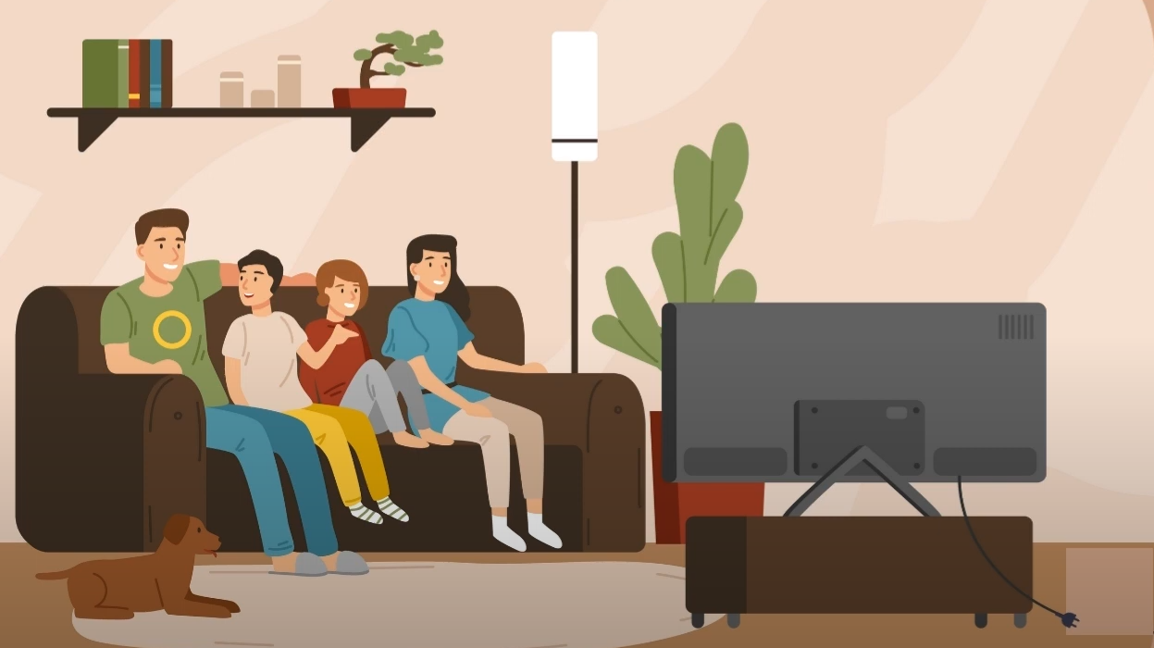

Slide 3
TV is unplugged

Slide 4
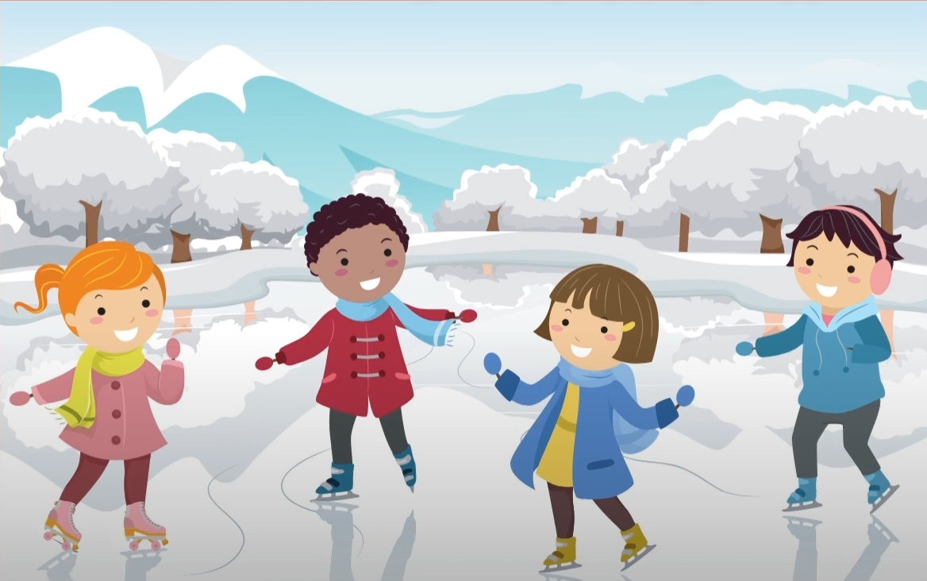

Slide 5
The girl is wearing roller skates instead of ice skates

Slide 6
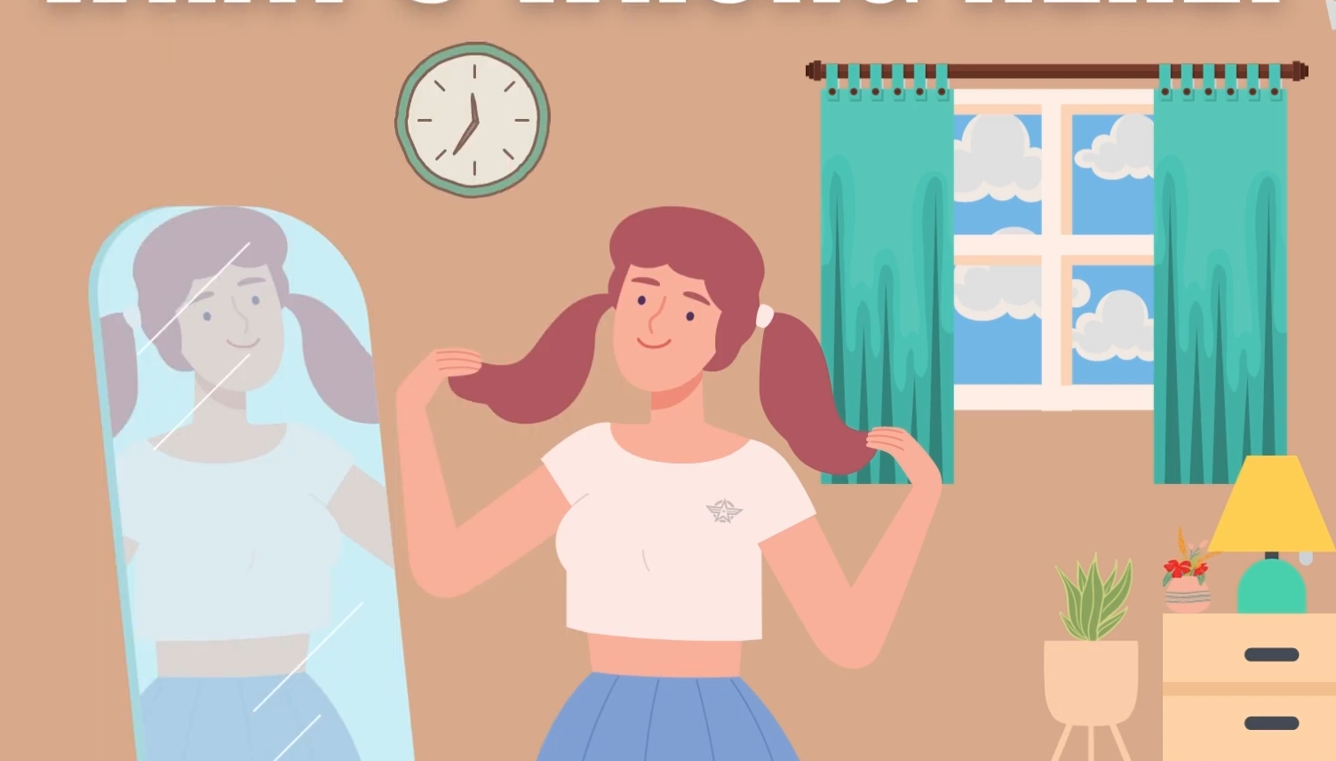

Slide 7
No reflection of logo

Slide 8
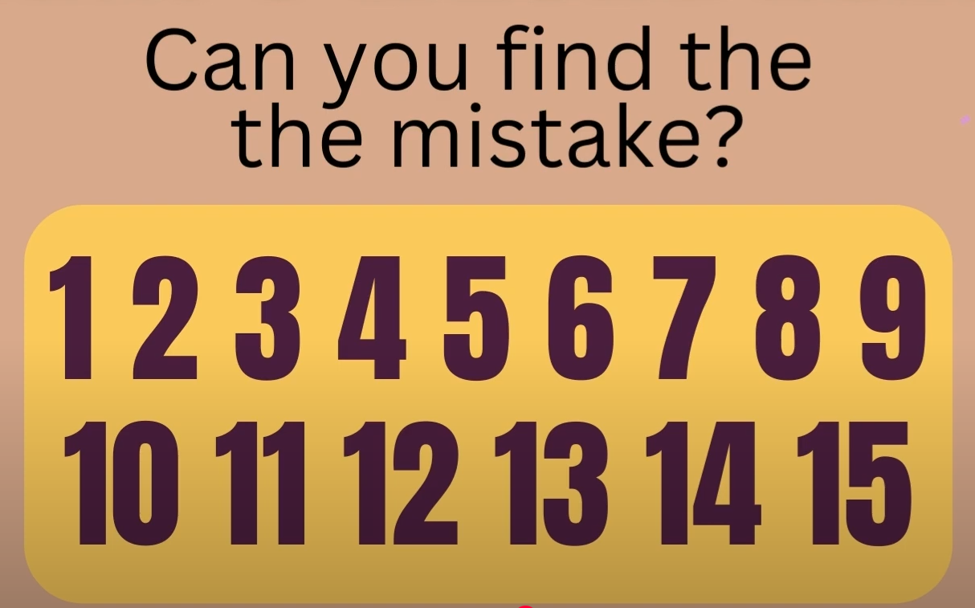

Slide 9
The word ‘the’ appeared twice

Slide 10


Slide 11
The letter ‘B’ instead of 8

Slide 12
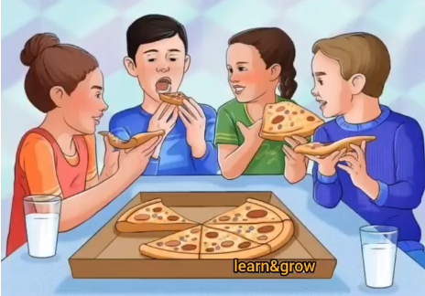

Slide 13
Only 3 slices are gone but there are 4 people

Slide 14
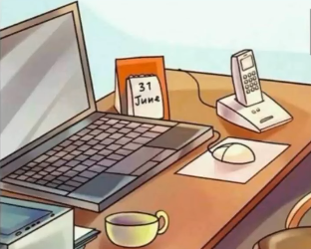

Slide 15
In June only 30 days

Slide 16
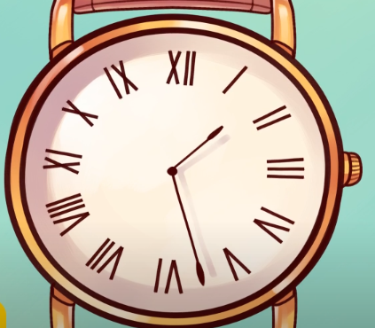

Slide 17
9 and 11 switched

Slide 18
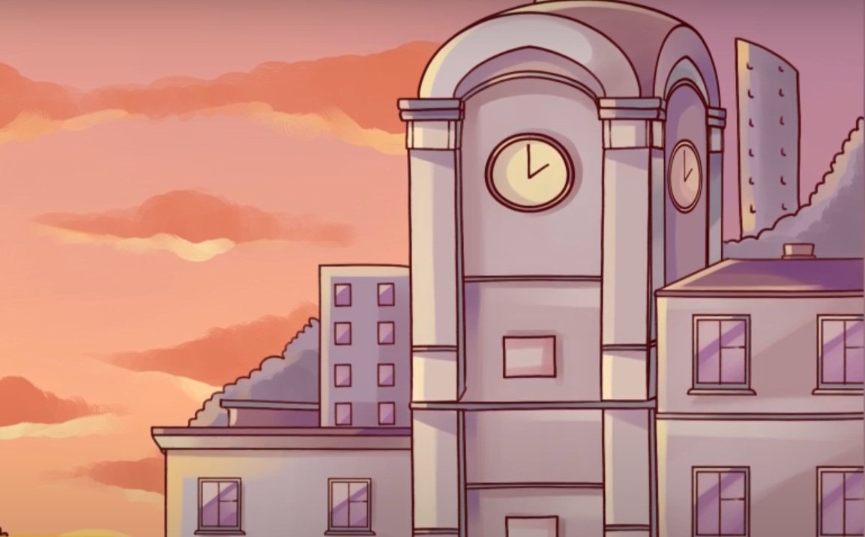

Slide 19
According to that time sunset is impossible

Slide 20
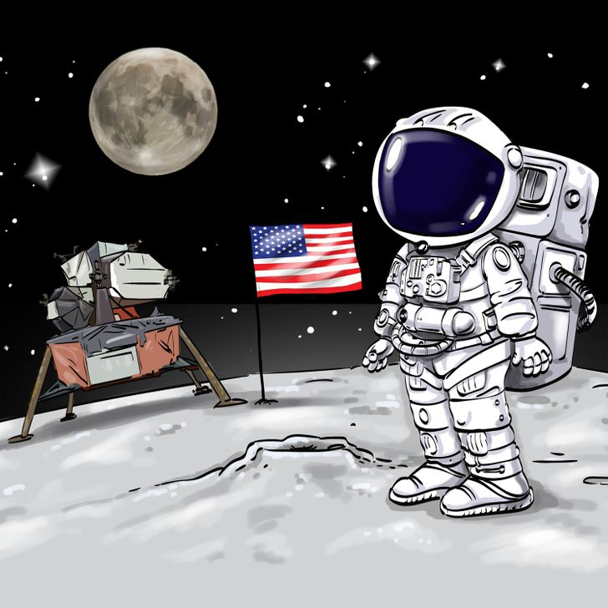

Slide 21
Moon

Slide 22
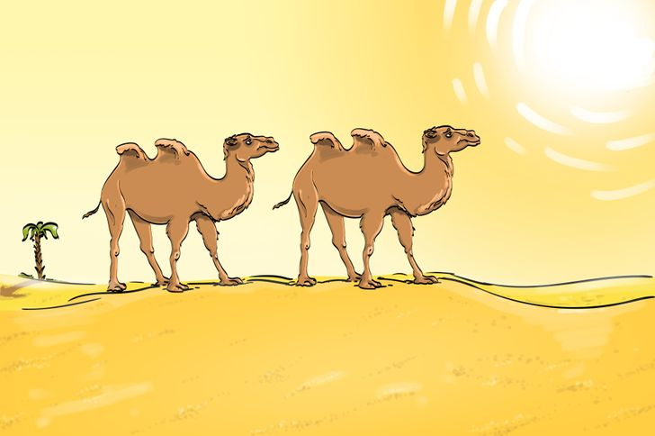

Slide 23
No Shadows of Camel

Slide 24
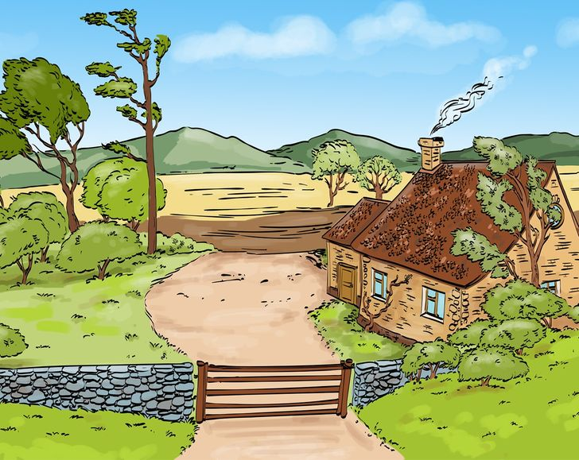

Slide 25
The wind is blowing in different direction

Slide 26
The wind is blowing in different direction

Slide 27
THANKYOU……………….!

